Slide 1
Employee monthly pay slip
Prepared For
Candice Nel Development Manager MYOB NZ Limited
Prepared by
19-Dec-2015
Madhavan

Slide 2
problem
When I input the employee's details: first name, last name, annual salary(positive integer) and super rate(0% - 50% inclusive), payment start date, the program should generate payslip information with name, pay period, gross income, income tax, net income and super.
The calculation details will be the following: • pay period = per calendar month • gross income = annual salary / 12 months • income tax = based on the tax table provide below • net income = gross income - income tax • super = gross income x super rate
Notes: All calculation results should be rounded to the whole dollar. If >= 50 cents round up to the next dollar increment, otherwise round down. The following rates for 2012-13 apply from 1 July 2012.
Taxable income Tax on this income 0 - $18,200 Nil $18,201 - $37,000 19c for each $1 over $18,200 $37,001 - $80,000 $3,572 plus 32.5c for each $1 over $37,000 $80,001 - $180,000 $17,547 plus 37c for each $1 over $80,000 $180,001 and over $54,547 plus 45c for each $1 over $180,000 The tax table is from ATO: http://www.ato.gov.au/content/12333.htm
Example Data
Employee annual salary is 60,050, super rate is 9%, how much will this employee be paid for the month of March ? • pay period = Month of March (01 March to 31 March) • gross income = 60,050 / 12 = 5,004.16666667 (round down) = 5,004 • income tax = (3,572 + (60,050 - 37,000) x 0.325) / 12 = 921.9375 (round up) = 922 • net income = 5,004 - 922 = 4,082 • super = 5,004 x 9% = 450.36 (round down) = 450
Here is the csv input and output format we provide. (But feel free to use any format you want) Input (first name, last name, annual salary, super rate (%), payment start date): David,Rudd,60050,9%,01 March – 31 March Ryan,Chen,120000,10%,01 March – 31 March Output (name, pay period, gross income, income tax, net income, super): David Rudd,01 March – 31 March,5004,922,4082,450 Ryan Chen,01 March – 31 March,10000,2696,7304,1000

Slide 3
List any assumptions.
Employees are Australian Residential
Income Tax Year 2015

Slide 4
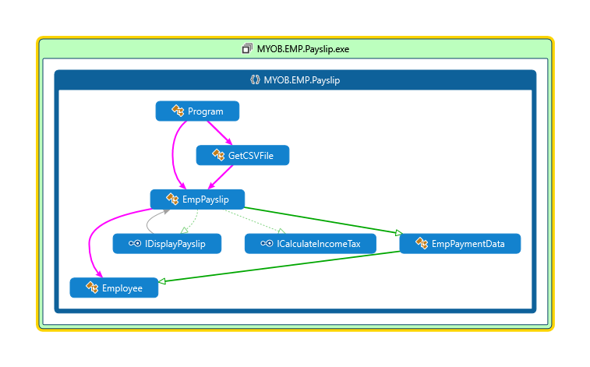
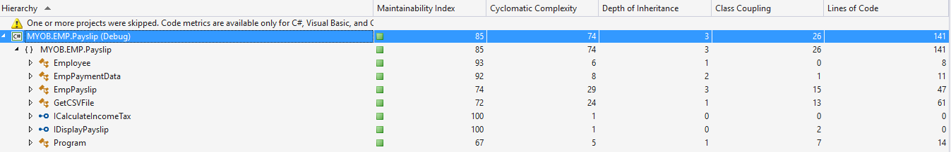
Code map and Code metrix

Slide 5
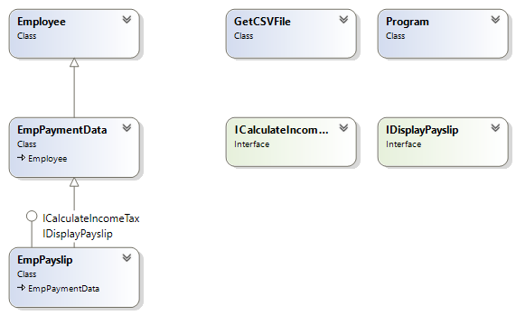
Class diagram

Slide 6
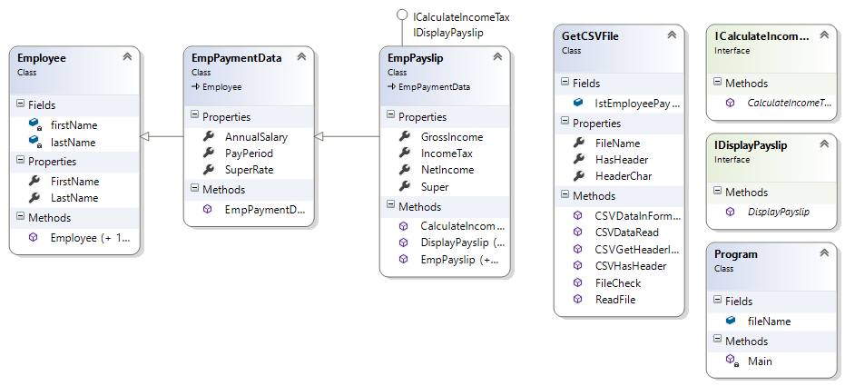
Class with properties and Methods

Slide 7
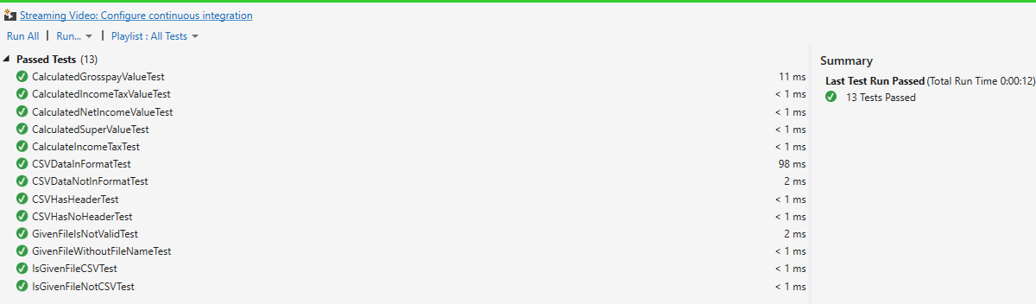
Test cases

Slide 8
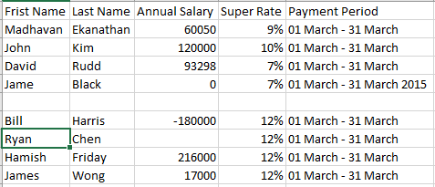
Test Data

Slide 9
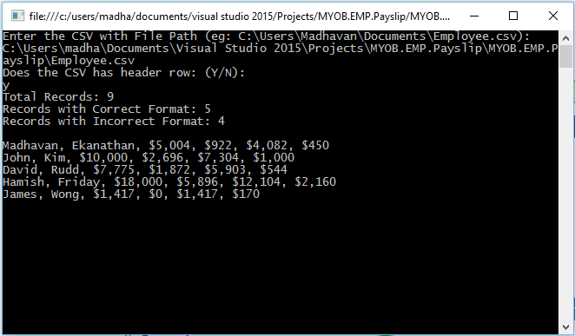
Results

Slide 10
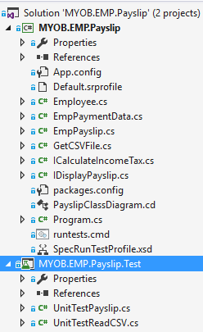
Project Structure
Download the files via Github https://github.com/aemadhavan/Payslip
MYOB.EMP.Payslip Solution has two projects
MYOB.EMP.Payslip – C# Console Application
MYOB.EMP.Payslip.Test – Unit Test Project with Test case

Slide 11
Used Design Principles and patterns
Object Orient Design
Class
Constructor
Inheritance
SOLID Design Principles
Single Responsibility Principle
Open Closed Principle
Interface Segregation Principle
Design Pattern
Dependency Injection
Bridge Design Pattern
Chain of Responsibility
Iterator Pattern
Development Approach
Test Driven Development (TDD)

